Slide 1



ARJUN COLLEGE OF TECHNOLOGY
DEPARTMENT OF MECHANICAL ENGINEERING
SMART INDIA HACKATHON
STAIRS CLIMBING 4 WHEELED TROLLEY
TEAM MEMBERS
ANANDHAVELAN M
LINGAMMARISWARAN M
SUPRIYA P
VIJAYALAKSHMI R
LOKESHWARAN C
PRASANTH S
MENTOR: M. NAVEENKUMAR, AP / MECH

Slide 2
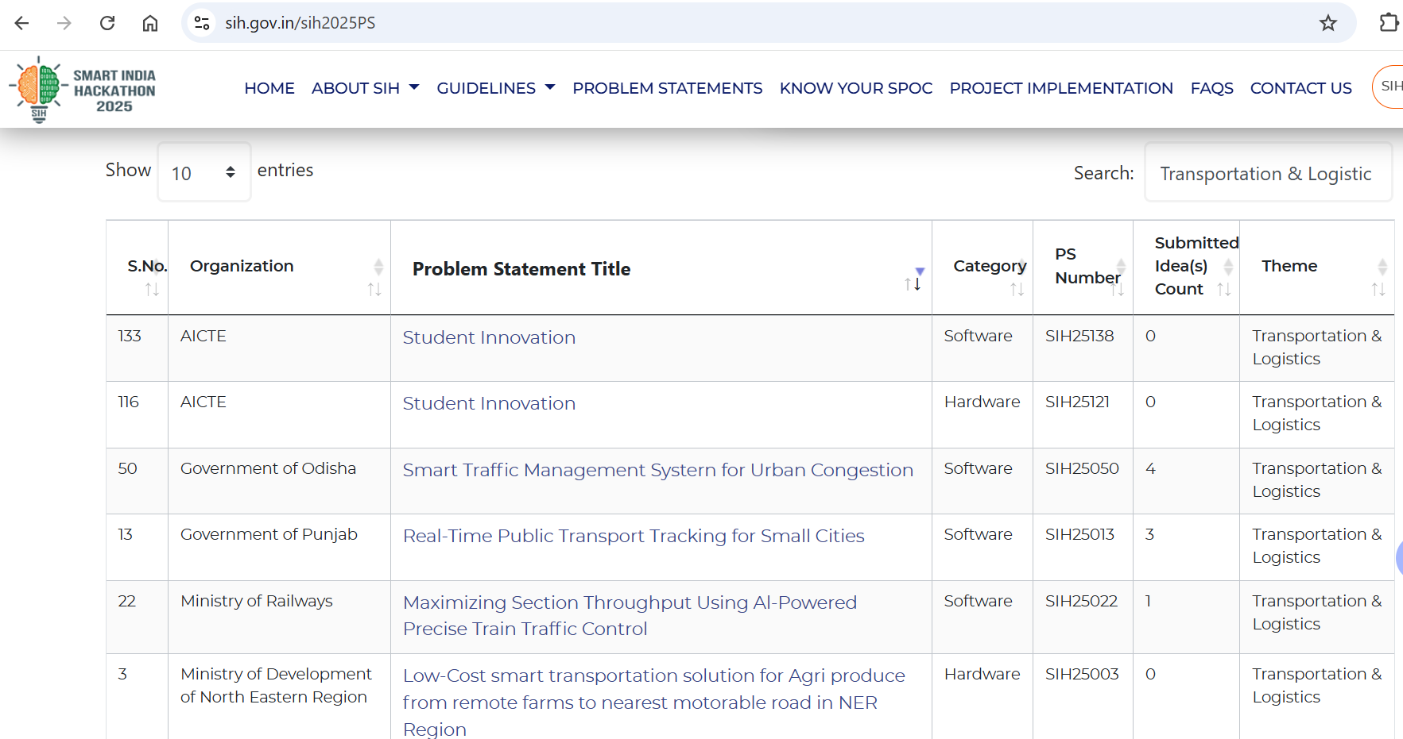
SMART INDIA HACKATHON
S. No. : 116
Organization : AICTE
Problem Statement Title : Student Innovation
Category : Hardware
Submitted count : 0
Theme : Transportation & Logistics

Slide 3
Problem Statement
Material Handling Equipment plays a major role in everyday life, trolleys place a crucial role in domestic material handling situations.
While handling materials from ground floor to higher floors, it is very difficult to carry.
Hence Stairs climbing trolleys were introduced. But that too have some disadvantages.
Carrying heavy loads and support for the loads also major concern in domestic usage.
They usually carry less weight compared to standard flat-surface trolleys.
Overloading can damage the mechanism or make it unsafe.
Carrying complex shapes also is difficult in existing design.
There is possibilities of slip while climbing.

Slide 4
THEME
Climbing Stairs
Avoid Slip
Heavy Loads
Carry complex loads
Balance
User friendly

Slide 5
COMPARISON OF EXISTING DESIGN & PROPOSED DESIGN
Parameters | Existing Design | Proposed Design
Load carrying Surface | Overhanging (bottom side) | Entire surface
Wheel thickness | 20mm to 25mm | 30mm to 40mm
Support for load | Front side | Fully closed
Maximum load carrying capacity | 150 kg | More than 220 kg
Shape of load | Blocks & Cylindrical loads only (non slip loads) | Any shape can carry
Slipping Issue | Possibilities of slipping while climbing upward | No slip occur while lifting

Slide 6
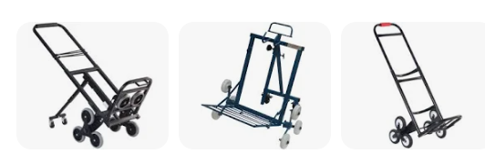
EXISTING DESIGN

Slide 7
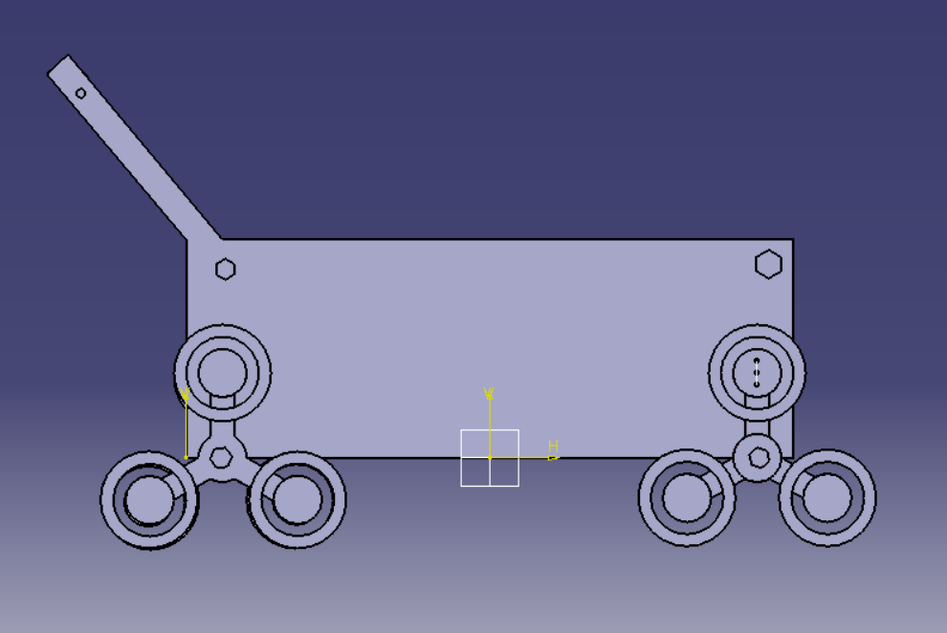
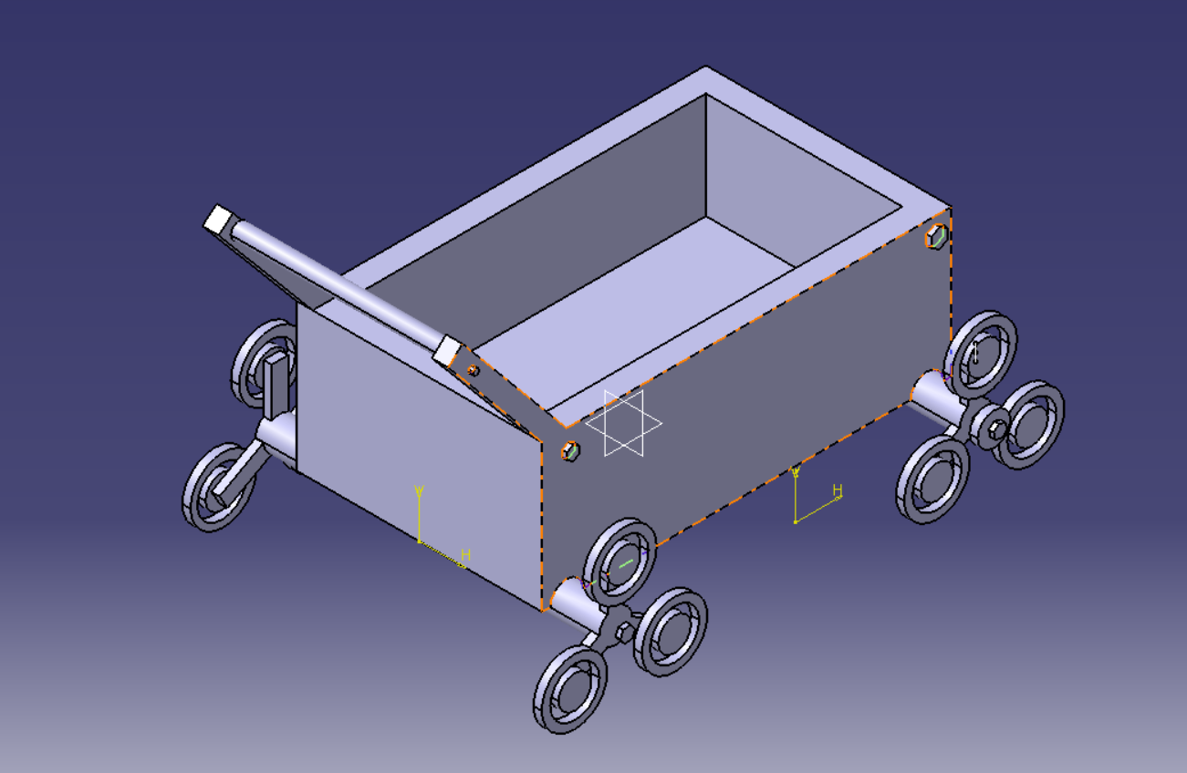
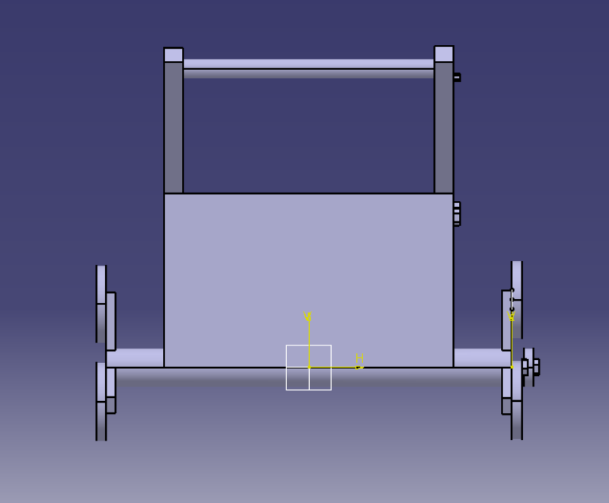
PROPOSED DESIGN
3D Modelling using CATIA

Slide 8
ADVANTAGES
Since the wheel can move in forward direction, slipping can be arrested through ratchet and pawl mechanism.
Mechanism can be manually unlocked, reverse direction also can be achieved whenever required.
Can lift heavier loads
Balancing of loads can be achieved
Loads with complex shape can be carried

Slide 9
APPLICATIONS
Construction field
Manufacturing industries
Malls
Education institutions
Hotels
Transportation & Logistics companies
Warehousing

Slide 10
CONCLUSION
Heavy loads can be easily lifted
By using this trolley the human effort will get reduced
Accidents can be eliminated
Balancing of loads and easy material handling can be done
FUTURE SCOPE
By using IoT we can automate the trolley with the help of motors and other accessories
With the help of sensors and GPS systems we can locate the trolley
Implementation of automation can help industries for mass production

